Slide 1
Recommending a location for a new it company office in paris
Applied Data Science Capstone
IBM Data Science Professional Certificate
November 2018
Performed by MRABAH Yassine

Slide 2

Contents:
1- Introduction to the problem
2- Data scraping
3- Used methodology
4- Results
5- Conclusions

Slide 3
1- Introduction to the problem
My employees requirements
My requirements
Accessibility to metro stations
I am an IT company, I need to establish a new office at the heart of Paris !
I need to make a logical investment, The price of a m² is expensive, so which neighborhood in Paris should I choose ?
Accessibility to various restaurants & spots
Accessibility to public parks and sport centers
My employees should be satisfied by the new office

Slide 4
2- Data scraping
Opendata.paris.fr
A real estate agency
The foursquare API
Stations data & locations
The price of a m² in each arrondissement in Paris
Coordinates of Paris
Restaurants locations
Public parks, sport centers locations
We’re going to collect data from these different sources, and then we will create a new data frame where we will combine the most important “columns” extracted from each source

Slide 5
3- Used methodology
2
Weights
We define the settlement index (a value between 1 and 10), we will select the neighborhood that has a value closer to 10
M² price affordability
4
1
Accessibility to public transport
Data from multiple sources as described in the previous chapter
2
3
Accessibility to various restaurants
Visualization of the results on a map
2
Comparison
Accessibility to public parks
1
Perform clustering analysis to find similar neighborhoods without calculating the settlement index
Accessibility to sport centers
1
Sum = 10

Slide 6
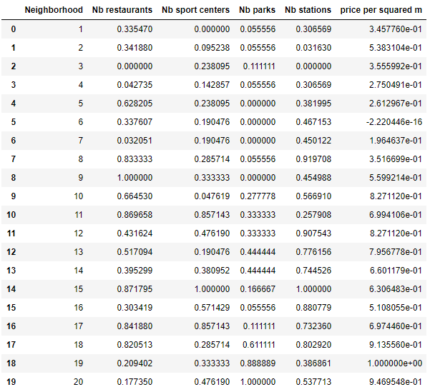
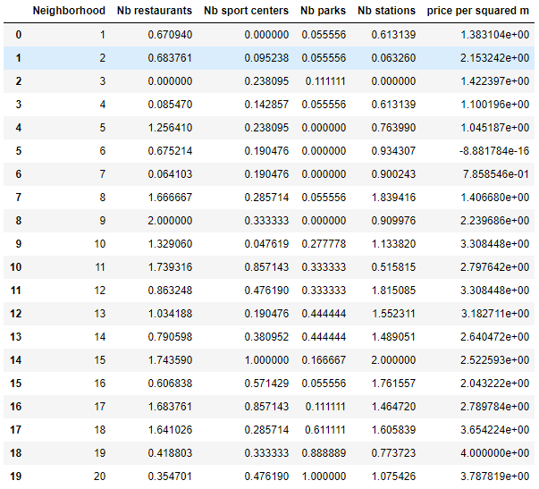
3- Used methodology
X 2
X 1
X 1
X 2
X 4
Data before and after applying the weights

Slide 7
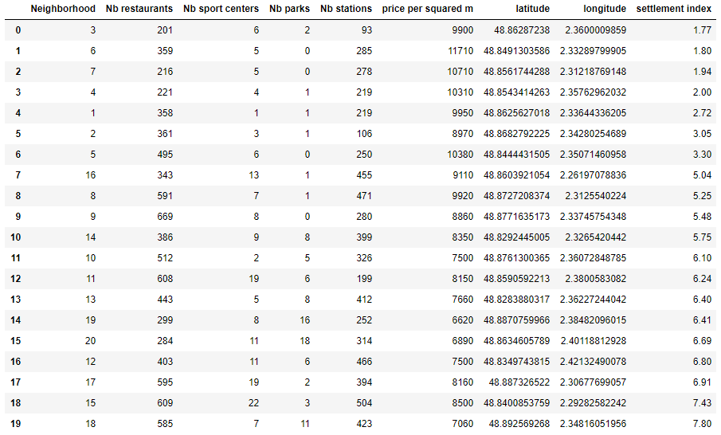
4- Results
Arrondissement = Neighborhood
Index < 4
4 < Index < 6
Index > 6
Arrondissements sorted by the settlement index

Slide 8
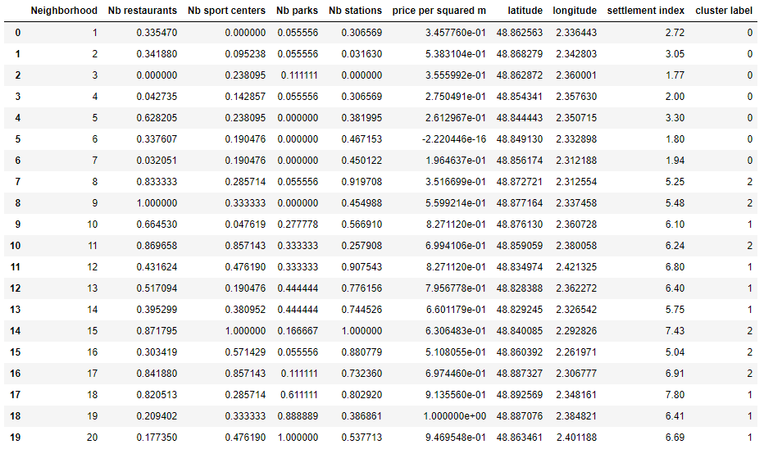
4- Results
Label = 0 corresponds very well to settlement index < 4
For label = 1 and 2, settlement index > 4
It is mainly = 5,6 and 7
An acceptable choice for a location starts from an index > 4
Results after performing clustering analysis for n = 3

Slide 9
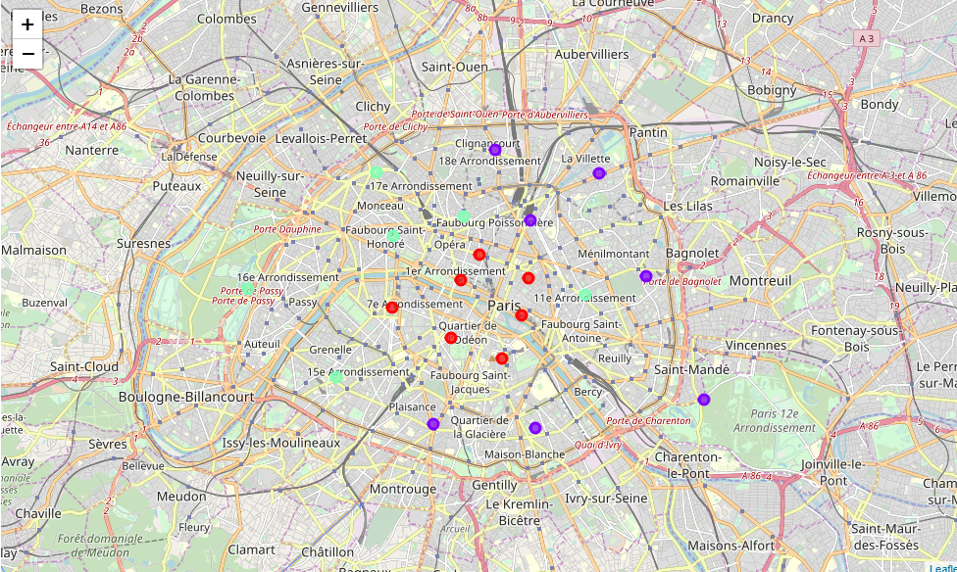
4- Results
The red circles correspond to the neighborhoods that we should avoid: It is a logic result because they are the heart of Paris and they are very expensive
The surrounding circle (sky blue + purple) correspond to the affordable ones: they respond to the company and the employees’ requirements

Slide 10
5- Conclusions
After calculating the settlement index, we were able to sort the neighborhoods, and provide a suitable choice to the company, and we were able to ensure that by performing clustering analysis
if settlement index > 6 : The company is advised to establish its new office in the corresponding neighborhoods
if settlement index is between 4 and 6 : It can be a solution
if settlement index < 4 : The company should absolutely avoid these choices
We found that : arrondissements : 1 to 7 should be avoided (< 4)
arrondissements : 16, 8, 9, 14 can be a solution ( 4< index < 6)
arrondissements : 10, 11, 13, 19, 20, 12, 17, 15, 18 are a good solution (index > 6)
As a suggestion, the company should establish the new office at the 18th arrondissement as it has the highest settlement index

